Slide 1
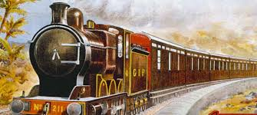
Presented by
HABIB UR REHMAN
Project Title
RAILWAY RESERVATION SYSTEM

Slide 2
Why we build this project?
It is easy to handle and it consume less time for registration when customer comes. It gives us benefit in many ways like, it store each entry automatically. We don’t need to spend our time in writing all information about customer.
The purpose of this software is to describe the Railway Reservation System which provides the rail timing details, reservation, enquiry, billing and cancellation on various types of reservation namely:
Confirm reservation for confirm seat
Reservation against cancellation
PNR generation
Scope of the Project in the Industry:
The scope of this project is limited to an engineering college. This project aims to maintain passenger and train information. Other scopes of this project are as follows:
Freight Revenue enhancement.
Passenger Revenue enhancement.
Improved and optimized service.

Slide 3
OVERVIEW:
This project aims at development of a Railway Reservation System that facilitates the Railway customers to manage their reservations and the Railway administrators to modify the backend databases in a User-Friendly manner. This project includes the following functions:
Add Record
Ticket reservation
Ticket Modification
Ticket Cancellation
Display record

Slide 4
Header Files :
There are two Header files used in this Project:
#include <iostream>
#include <string.h>
#include <conio.h>
#include <Windows.h>
Operators :
There are many operators used in it:
If Else
Array
String
Functions
Inheritance :
Class Account
Class Timing

